Slide 1
Programming in C ( Com412)
BSc CSIT First Semester
Mid-West University
By:
Dabbal Singh Mahara
2023

Slide 2
Course Objectives
The objective of this course is to make the students familiar with the basic principles of programming and development of software systems.
It encompasses the use of programming systems to achieve specified goals, identification of useful programming abstractions or paradigms, the development of formal models of programs, the formalization of programming language semantics, the specification of program, the verification of programs, etc.

Slide 3
Course Contents
Introduction to the C Language,
Variables, Data Types and Operators
Input / Output Management
Selection statements and Loops
Arrays and Strings
Functions
Pointers
Structures and Unions
File Input / Output

Slide 4
Lab Work
Laboratory work is essential in this module.
We will have extensive lab works in this course.

Slide 5

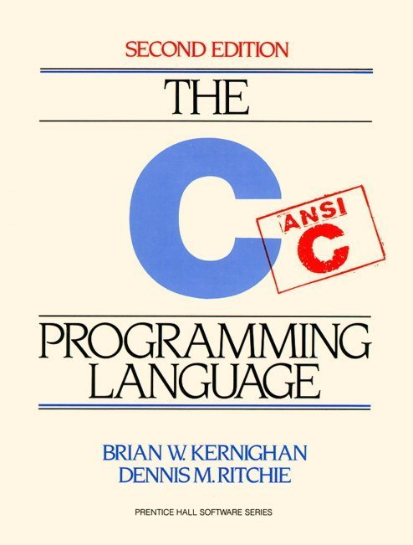
Text Books

Slide 6
EVALUATION
Internal Evaluation (40%)
Home works & Assignments
Attendance, presentation
Mid Term Examination
Lab Works
Final Examination (60%)

Slide 7


